Slide 1

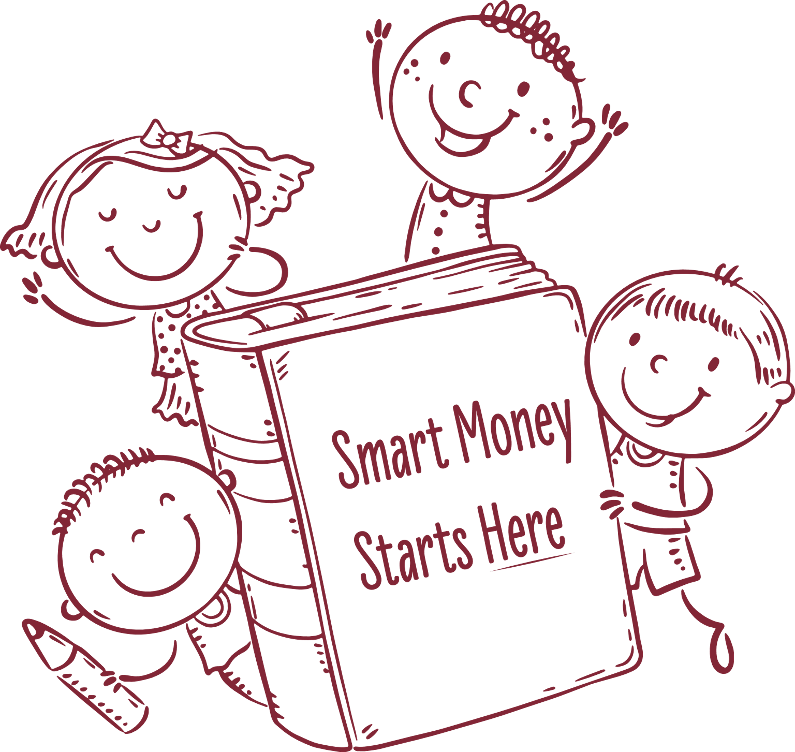

Money Smarts
Your Guide to Banking & Growing Wealth
September 16th, 2025

Slide 2
If I gave you $100 today…
What would you do first: spend, save, or invest?
"Your choices today affect your money in the future."

Slide 3
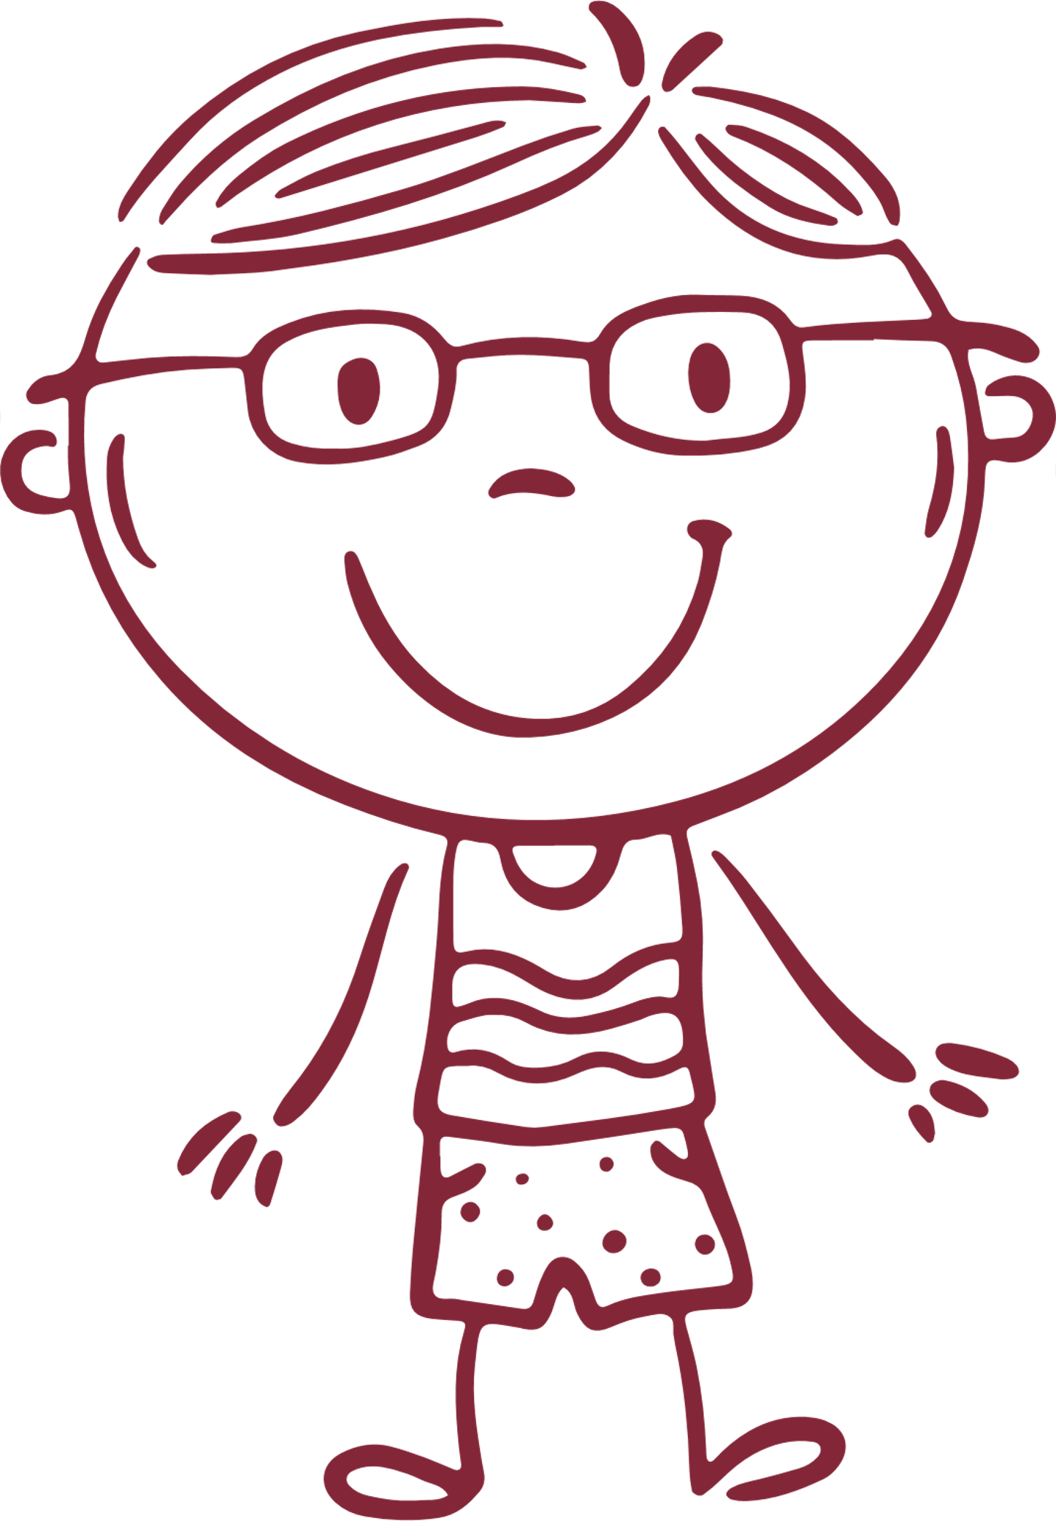

The Power of Starting Early
Alex
Alex saves $20 a month, starting at age 15
Jordan
Jordan saves $20 a month, starting at age 25

Slide 4

Each round = 1 year
Alex starts saving at age 15
  Place 1 candy in Alex’s bowl at the start
Jordan starts saving at age 25
  Place 1 candy in Jordan’s bowl beginning at Round 11
Growth each year:
  Savings account = +1 candy
  Investment account = +2 candies
Candy Simulation:
How Money Grows

Slide 5

Where Can Your Money Grow?
Savings Account
  Safe, small growth
CD (Certificate of Deposit)
  Locked, higher growth
Investment Account
  Riskier, bigger growth potential
Retirement / IRA
  Long-term, planning for future
  Different accounts help your money grow in different ways. Some are safe, some grow faster, and some are for thinking way ahead.

Slide 6
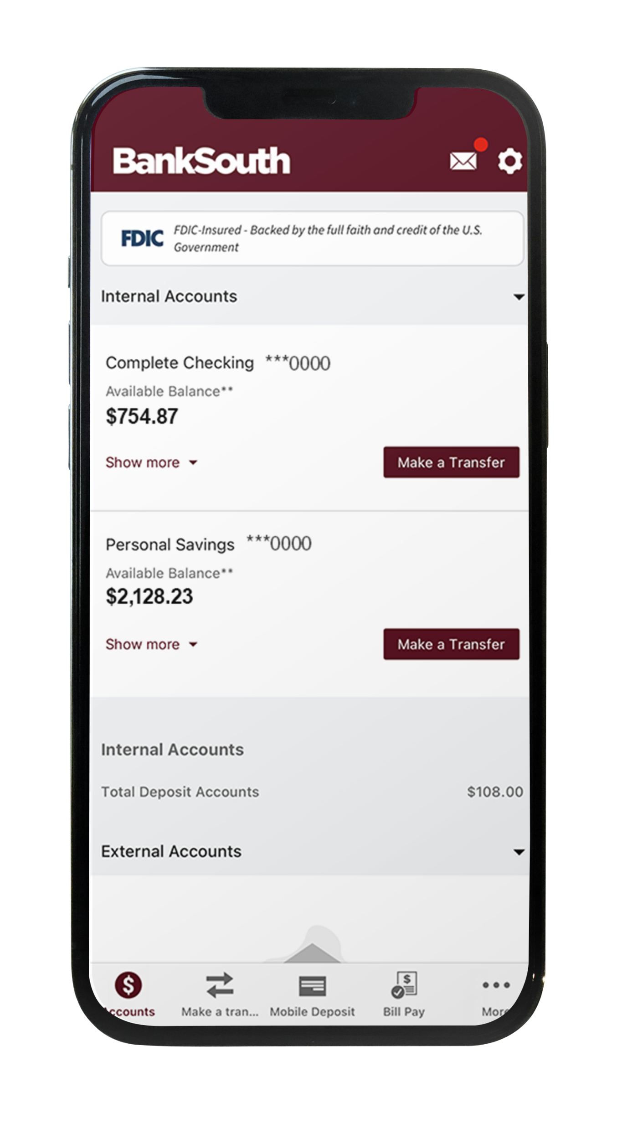
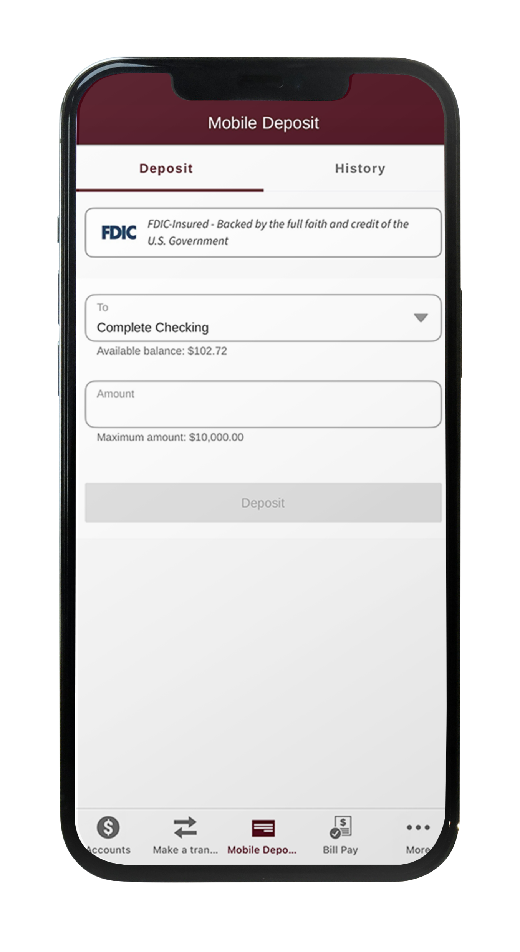
Banking in Your Pocket
Check balances anytime
Deposit money with your phone
Transfer between accounts
Set savings goals
Pay safely without carrying cash
Never share your password!
Turn on alerts for safety!

Slide 7
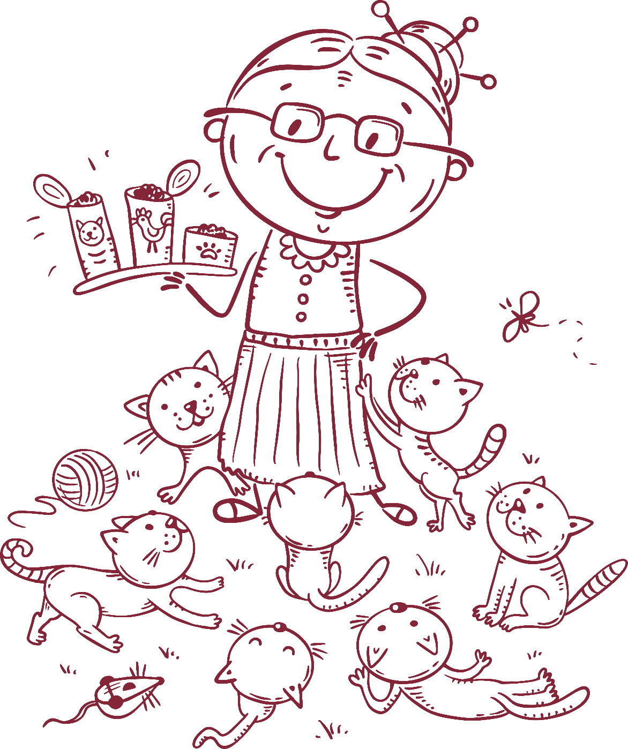
What Would You
Do With $50?
Grandma gives you $50 — would you save it, spend it, or transfer it?
Talk in pairs or groups
Share your ideas with the group

Slide 8
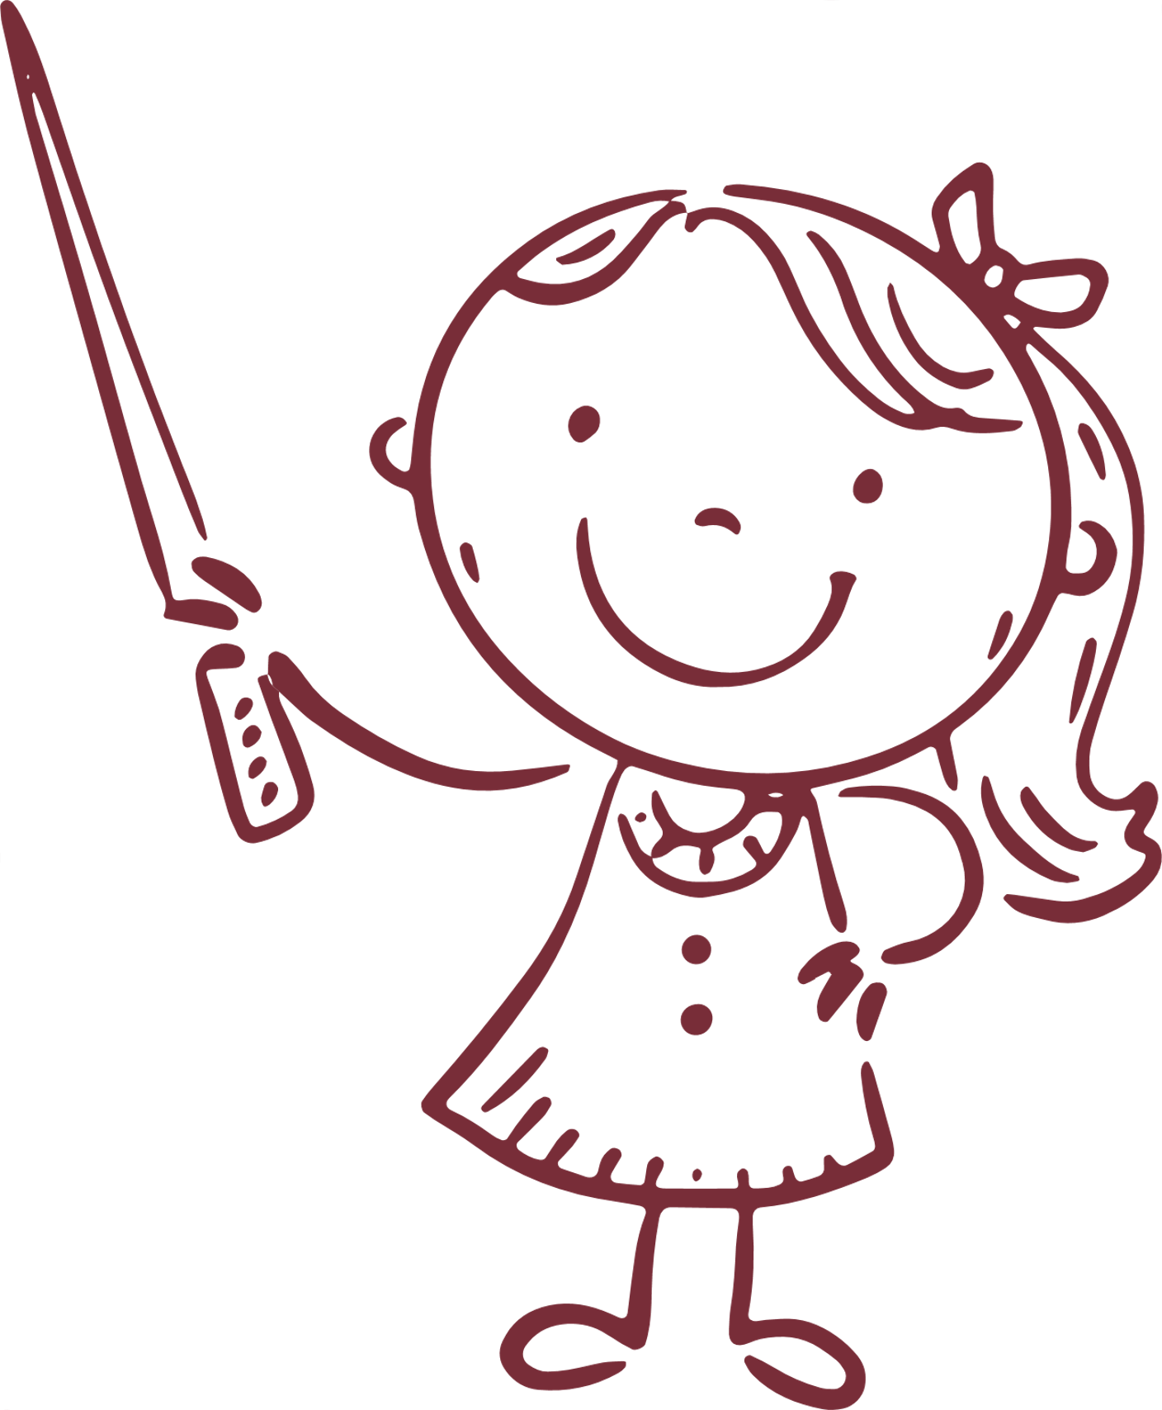
Why Have a Bank Account?
Banks keep money safe from loss or theft.
Money can grow through accounts and interest.
Debit cards and apps make spending and saving easy.

Slide 9
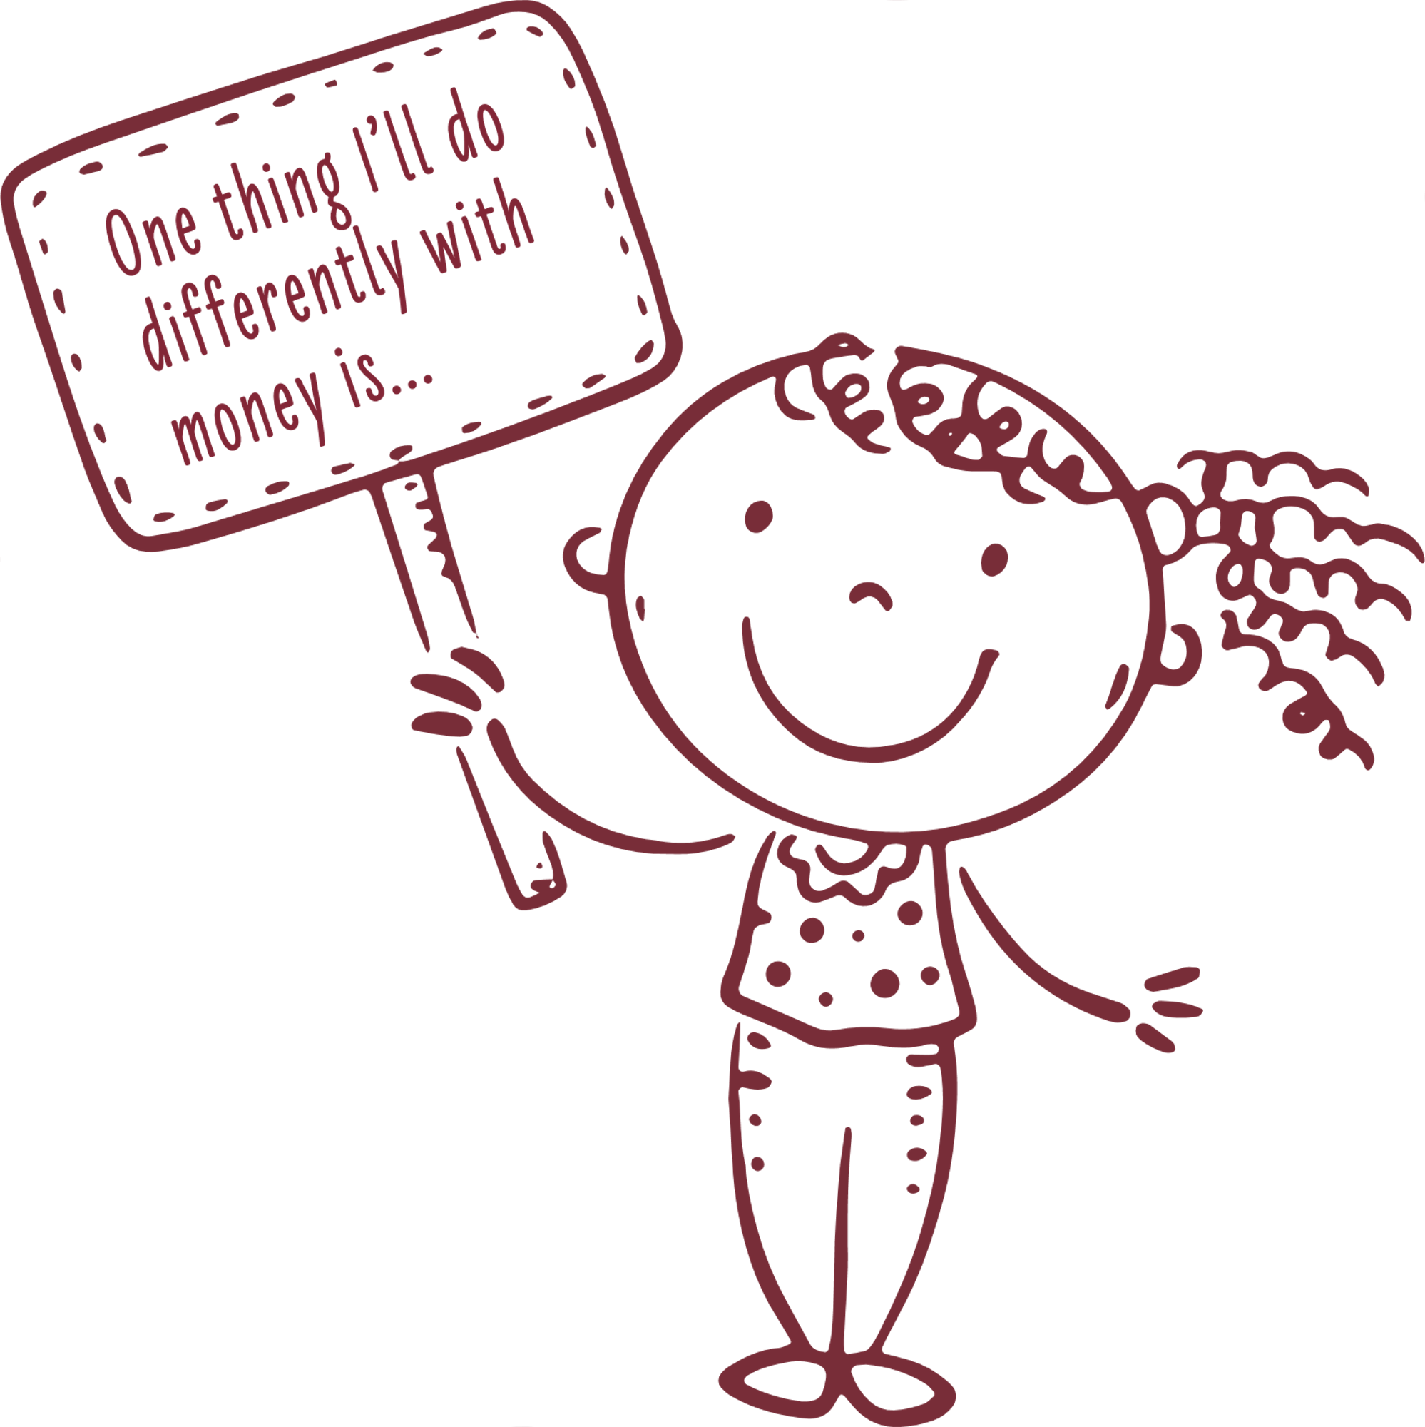
Your Money Challenge!
What’s one new thing you’ll do with your money?
Small steps now build big results later.
Write down your goal and share it!

